Slide 1
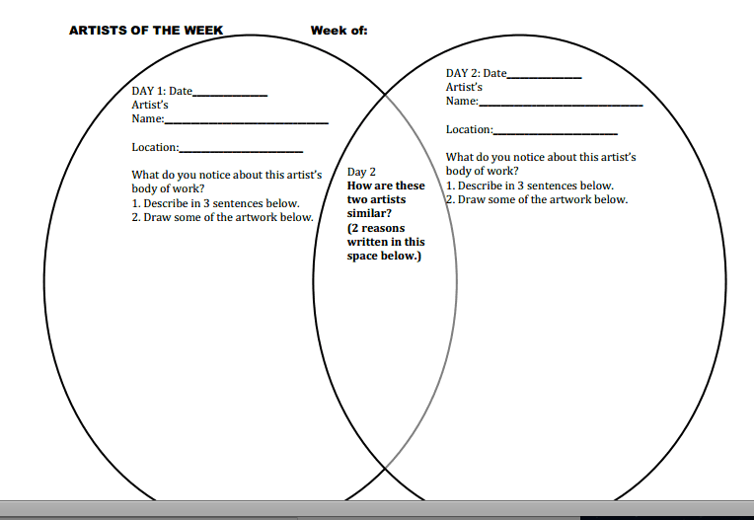
2 artists of the week
Sculpture – compare and contrast for week 11

Slide 2
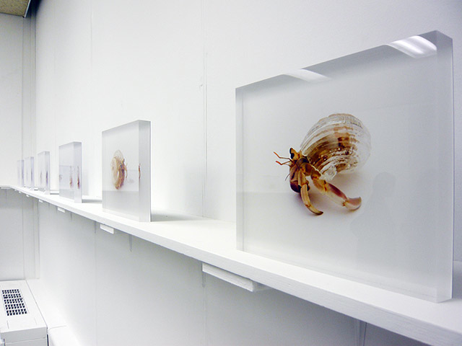
Artist #1
Artist: Aki Inomata (Japanese artist)
What: Translucent Hermit Shell Crabs Adorned with Architectural Cityscapes

Slide 3
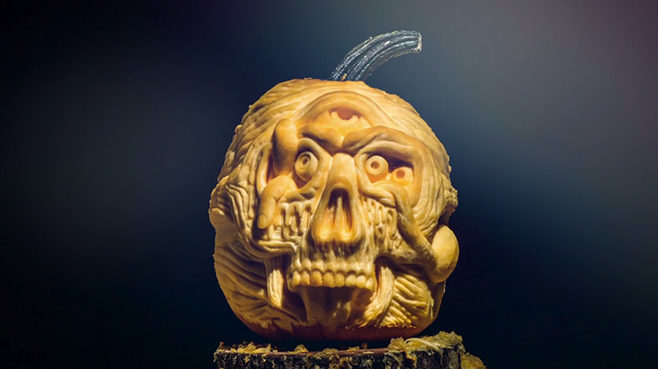
Artist #2
Artist: Chris Soria (professional pumpkin carver from New York City)
What: Creepy Pumpkin Carving Timelapse

Slide 4
how are this week’s artists similar?

