Slide 2
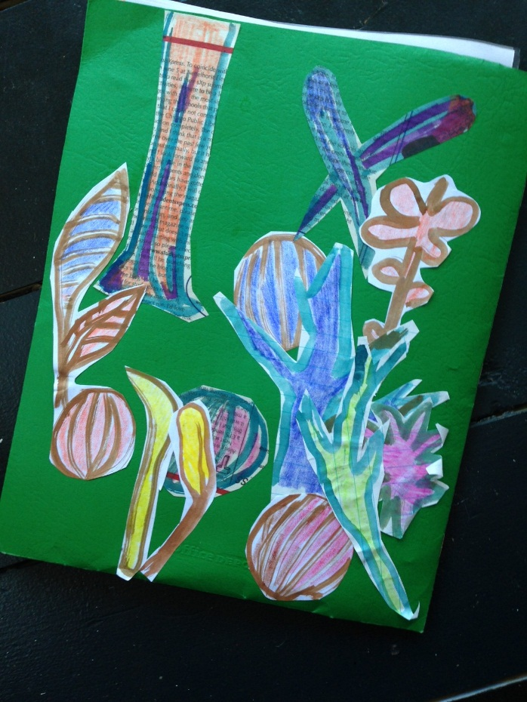
Front and back of finished folder

